Slide 1
Shopping App
A java console application

Slide 2
Introduction
3
This Project simulates the working of an shopping app where customers can buy products. Our Shopping App is purely console – based application and is implemented using the programming language JAVA.
PANELS :
This Java Console Application contains mainly two panels :
ADMIN PANEL : functions providing like add product, delete product, delete product, search product
CUSTOMER PANEL : functions provided like buying products and making payments

Slide 3
Concepts brought to life
String Manipulation
1
Collection Framework
2
BufferedReader
3
String Tokenizer
4
Regular Expression
5
Classess and Objects
6
Exception Handling
7
File I/O
8

Slide 4
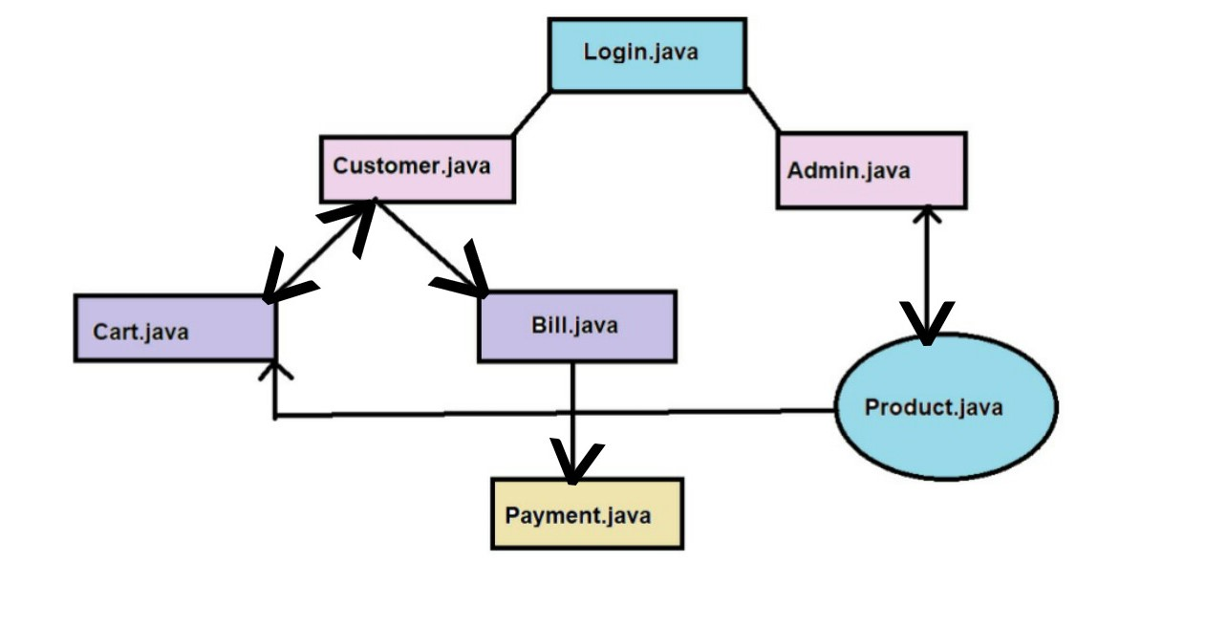
Architecture
B2B market scenarios
Cloud-based
opportunities
Develop winning strategies to keep ahead of the competition​
Capitalize on low-hanging fruit to identify a ballpark value​
Visualize customer directed convergence
Iterative approaches to corporate strategy
Establish a management framework from the inside

Slide 5
File Structure
Admin Section
User Section
Common Section
Admin.java
AdminService.java
Bill.java
Payments.java
Cart.java
Customer.java
Shop.java
User.java
UserMain.java
Main.java
Product.java

Slide 6
File Description
Admin.java : In this section we are providing functions like add, delete, view and search for managing products.
AdminService.java : We are registering customer through it, using subclasses of Admin.java
Cart.java : This is providing add to cart, view cart, remove product from cart.
Payment.java : The main function of payment class is to display bills and pay bills by calling Bills.java.
Bill.java : This class is called from the payment page through an object, this class contains details of a bill like a billing id, products purchased and total amount.
Customer.java : It is the call method to register customer for the shop
Products.java : Functions like adding, removing, altering product info, viewing and searching products implemented in this class.
​

Slide 7
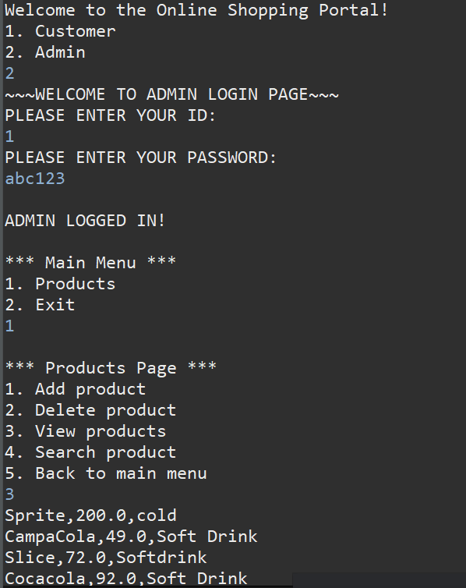
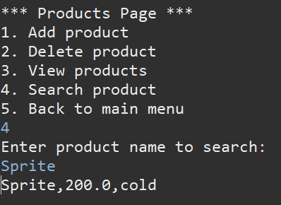
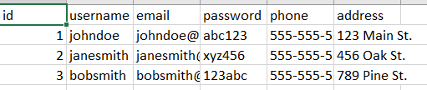
Highlights Of Our Project

Slide 8
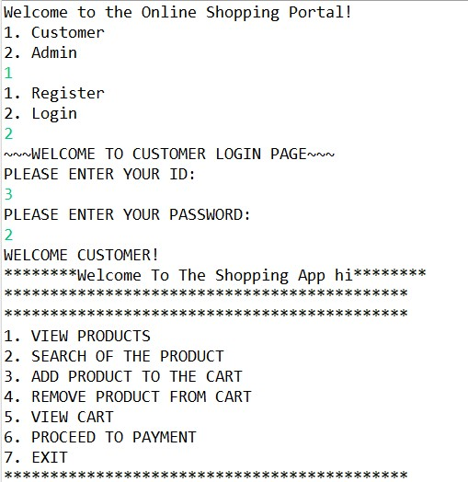
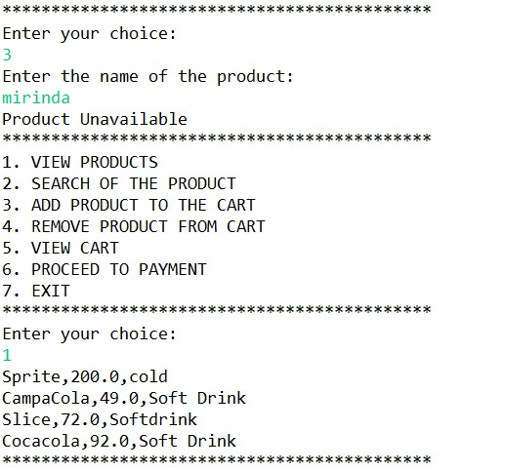
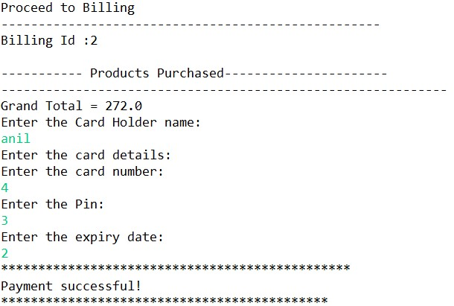
Highlights Of Our Project

Slide 9
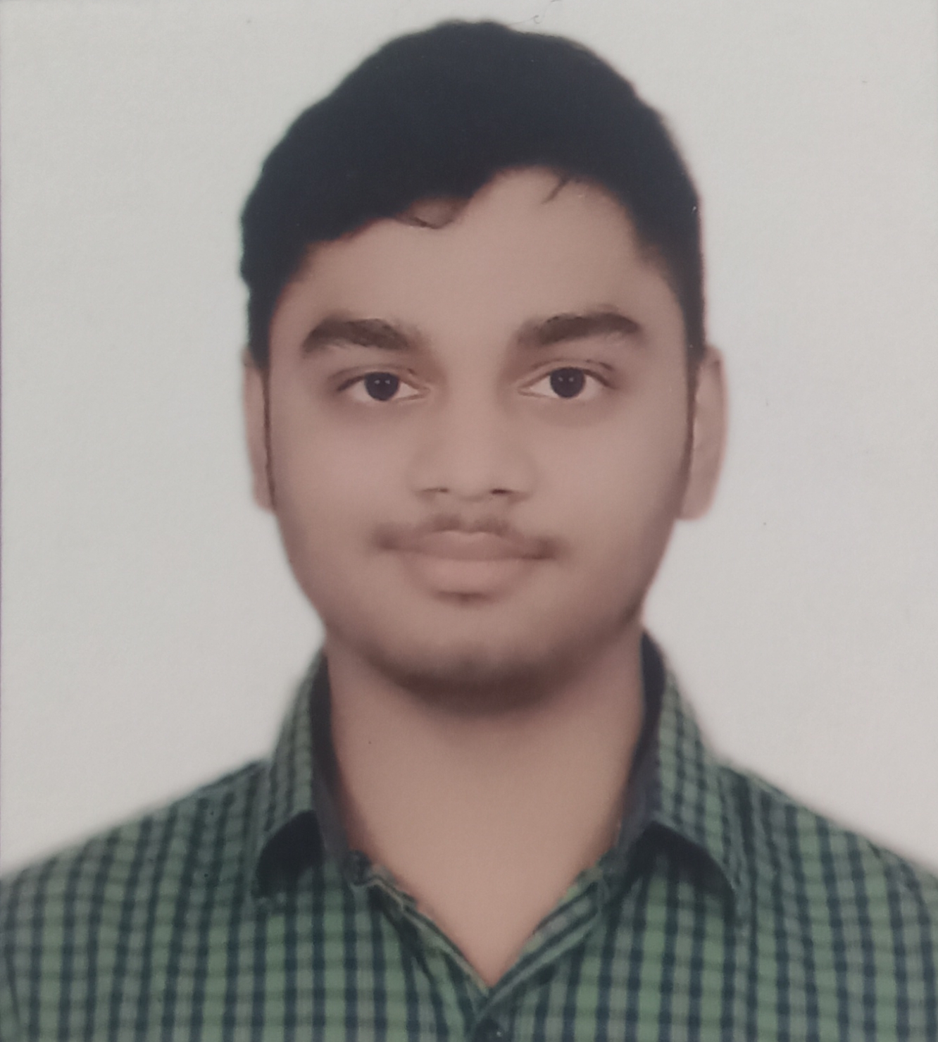
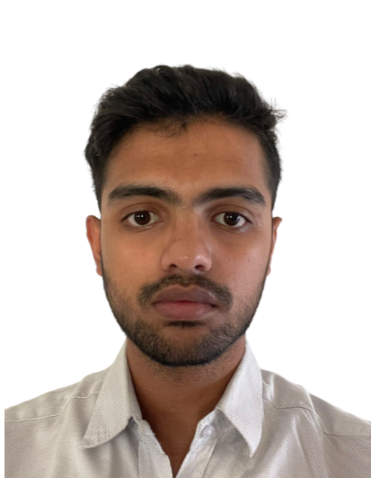


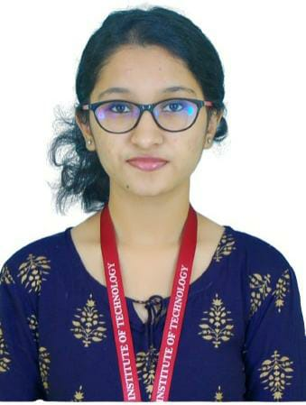
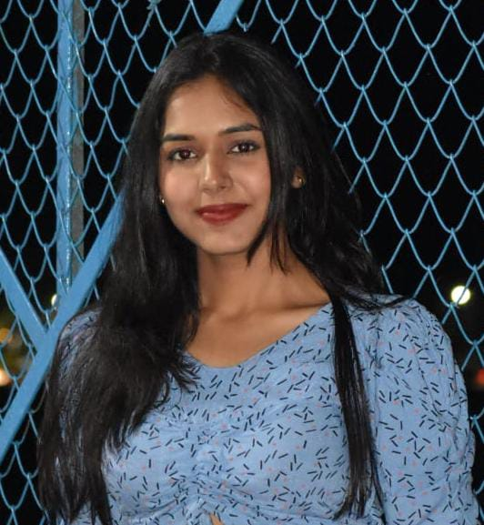


Our Team
Rishav Raj
Steve Prathik Fernandes
Janavi T N J
Muskan Jain

Slide 10
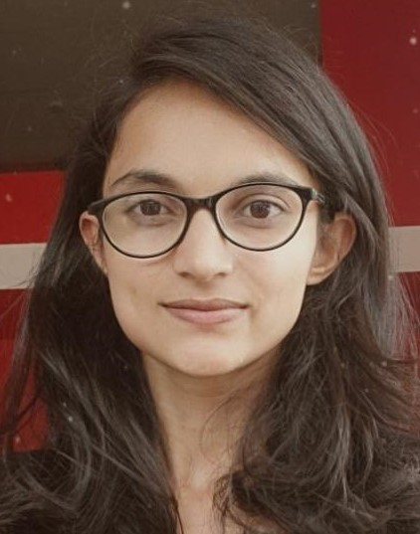
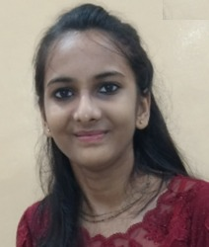
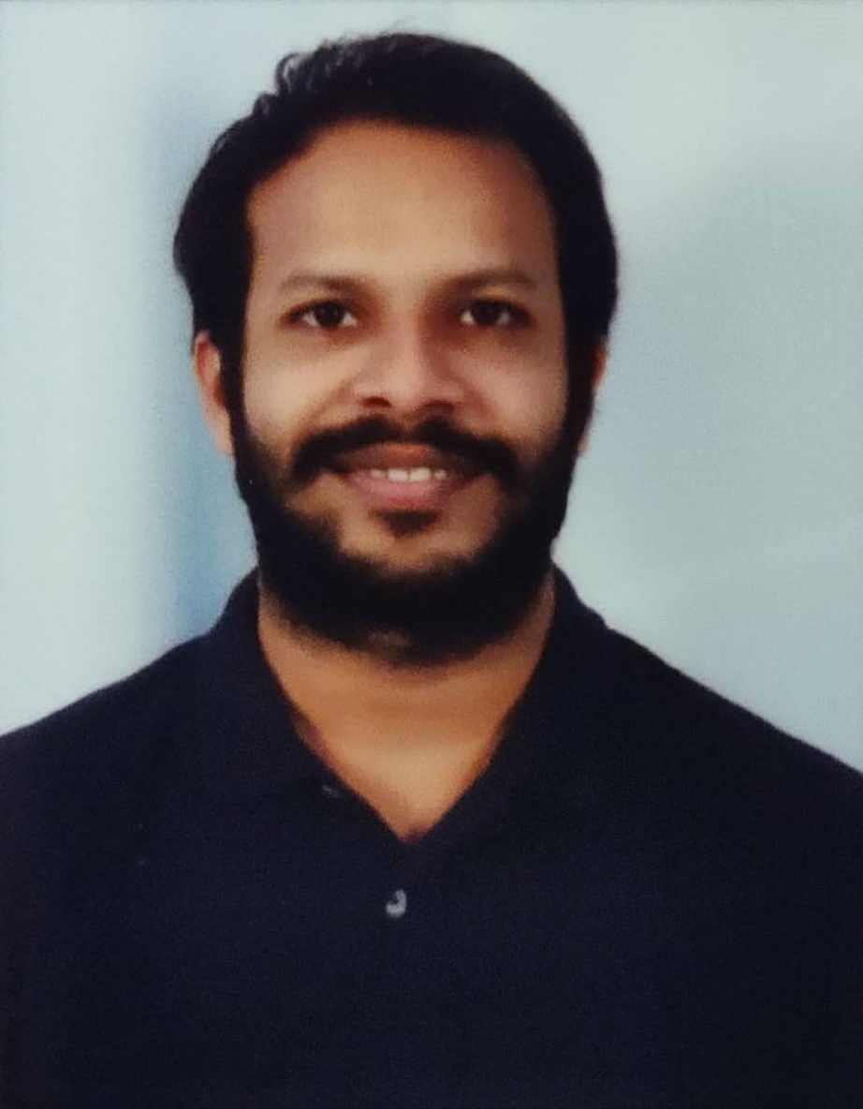
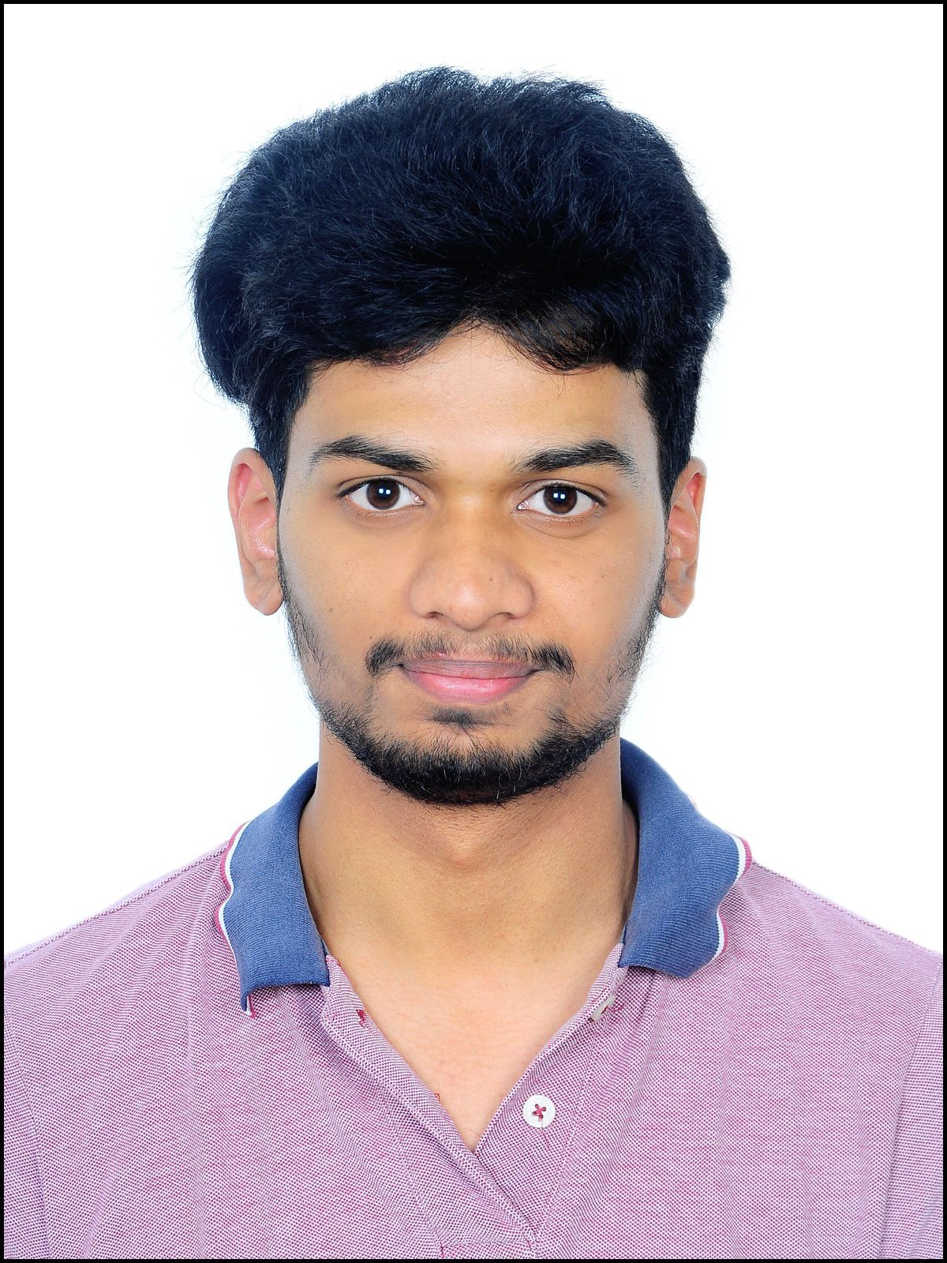



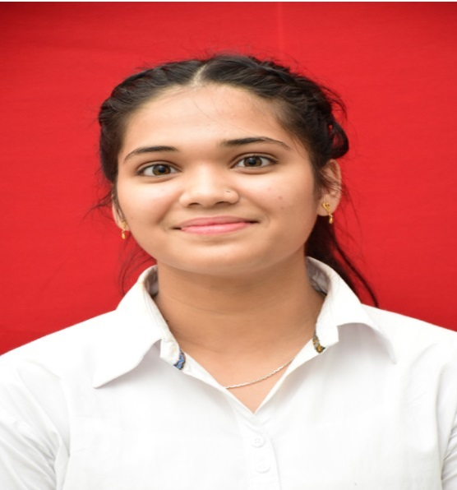
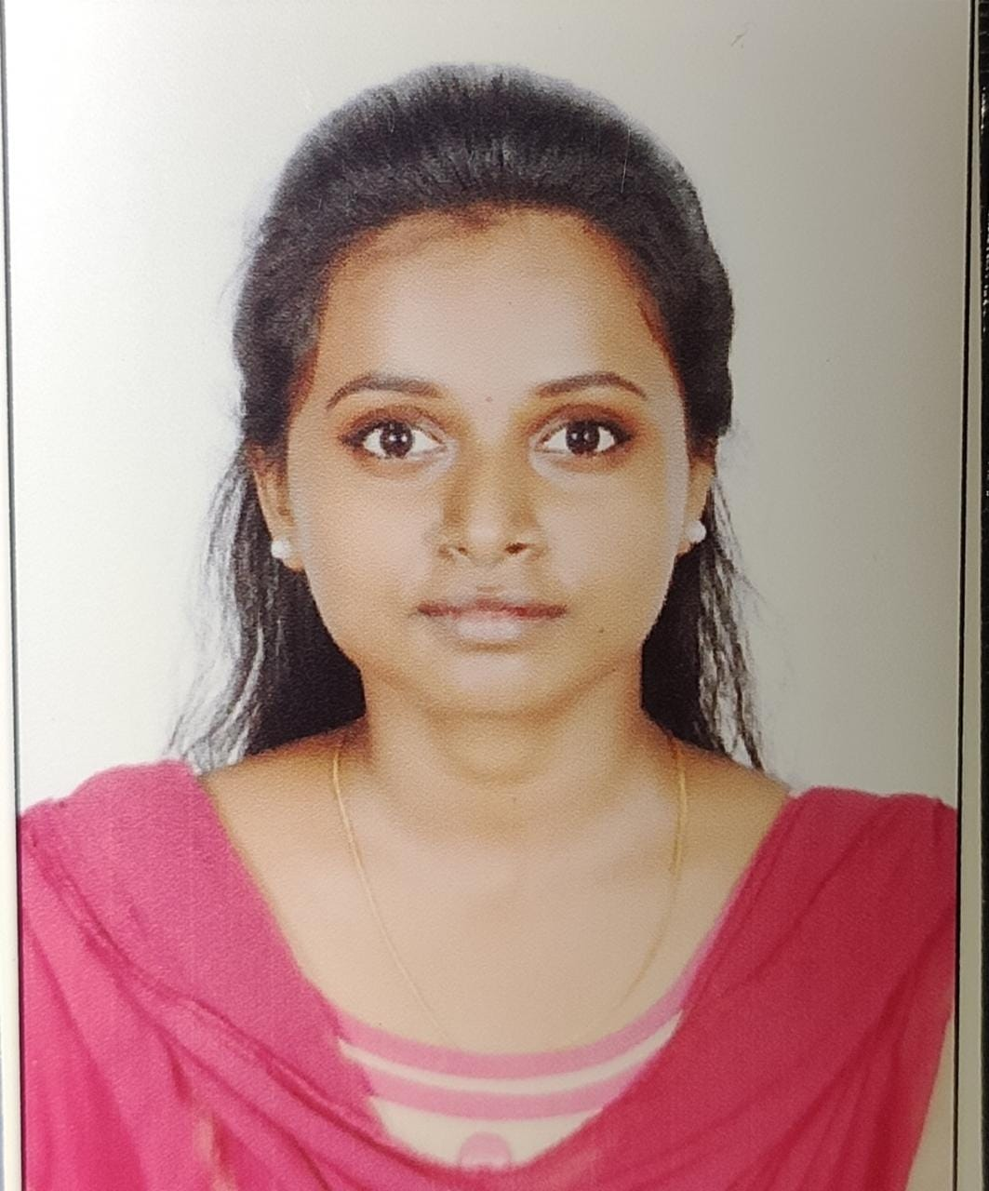
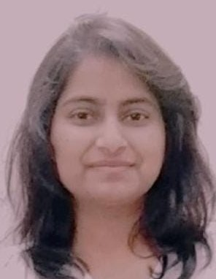
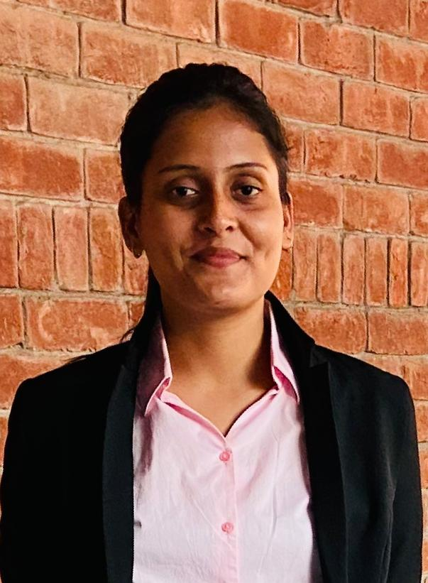

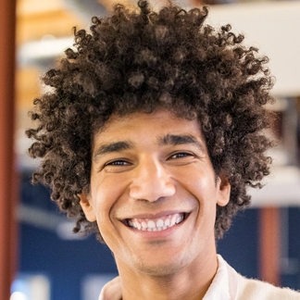


Our Team
Priyanka More
Trapti Gupta
Shivam Kumar
Nemani Anil
Nandani Malviya
Shirley Eunice
Riti Rathore
Anjali Kumari

Slide 11
Venkata Subbarao Boggarapu
Special thanks to :

